Slide 1


Slide 3
FINDING A CHURCH PLANTING NEXUS
Culture
Unreached people
Unentered territories
Lust, sin, death, financial crisis ect
WORD
WORLD
The Three Angels Message
Intercessory work of Christ
Ministry of the Holy Spirit
The Church Planting Center
Commitment Intercession
Equipping Methods
Money Spiritual Gifts
Natural abilities Perseverance
sending
CHURCH

Slide 4
ADVENTIST MISSION-
MISIÓN ADVENTISTA
INTER AMERICAN DIVISION
UNIONS | CONFE RENCES | UN-ENTERED | UN-REACHED | POPULA TION | GOAL- CHURCH PLANTING | GM PIONEERS
ATLANTIC CARIBBEAN | 4 |  | 10 | 1,049,185 | 27
BELIZE |  | 57 | 4 | 117,000 | 20 | 20
EAST VENEZUELA | 3 | 31 | 6 | 210,000 | 45 | 625
FRENCH ANTILLES-GUYANA |  | 17 | 11
GUATEMALA | 3 | 773 | 784,450 | 557,086 | 91 | 203
HAITI | 4 | 165 | 165 | 729,696 | 82 | 58
HONDURAS | 5 | 30 | 41 | 347,024 | 30 | 107
INTEROCE-MEXICO | 4 | 18 | 13 | 3,952,834 | 15

Slide 5
ADVENTIST MISSION-
MISIÓN ADVENTISTA
INTER AMERICAN DIVISION
UNIONS5 | CONFER | UN ENTERED | UN REACHED | POPULAT | CHUR/ PLANT. | GM PIONEERS
JAMAICA | 3 | 158 | 2 |  | 44
NICARAGUA | 1 | 3 | 3 | 10,850 | 10 | 50
NORTH COLOMBIA | 6 | 59 | 59 | 778,609 | 27 | 368
NORTH MEXICO | 1 | 4 | 4 | 178,751 | 4 | 3
SOUTH COLOMBIA | 5 | 244 | 130 | A.568,650 B.9,468,231 | 54 | 10
SOUTH MEXICO | 11 | 703 | 19 | 580,299 | 388 | 396
VENEZUELA ANTILLES | 7 | 32 | 38 | 2,500,000 | 647 | 6
TOTAL | 68 | 2,294 | 784,935 | 20,931,332 11,463,101 | 1.484 | 1,846

Slide 6
Problems With Information As It Stands
Inconsistent
  Mixed people groups and geographic areas
  Total for division is almost 800,000 people groups
    Not that many people groups in IAD (nor in the whole world)
    Mixed geographic territories and people groups
    Even so, probably not that many unreached geographic territories, realistically
Lacks specificity
  For instance, one union listed “ethic natives” and “indigenous natives” as people groups.
    Too general to be helpful
    Don’t know who you’re actually working for
    Can’t track it to know if you’ve accomplished goals

Slide 7
What can we do now with the information already gathered?
  Use the collected information to get started.
  Tell the unions this is a first step, and that the division will work with them to take the next step to improve, complete, and clarify the information
  Have unions indicate a few groups and territories they will begin targeting
Next step
  GFI Consulting works with division and unions to enable the carrying out of division goals
    Works with appropriate unions to do language group analyses
    Works with all unions to do church reach analysis
  These two analyses will provide the division and unions with the needed information in order to set and reach goals
    Language group analysis will identify unreached sociologically-determined groups. Will typically identify Hindu and Muslim groups. Can gather additional information, as needed, to make sure Jewish groups are identified. These analyses can be completed in time for mid-year meetings in May 2012.
    Church reach analysis will accurately identify unreached areas that need church planting. At least some church reach analyses can be completed in time for mid-year meetings in May 2012. If need be, the remainder can be finished at least in time for year-end meetings of 2012 and perhaps before then.

Slide 8
Recommendations
Each local congregation select 2% of its membership to be trained and deployed as Global Mission Pioneers
Each local conference do a simple analysis of the unentered territories and unreached people groups in linguistic categories to be submitted to the its union by January 30, 2012

Slide 9
Recommendations
Each local conference establish an Office of Adventist to give urgent attention to mission training, deployment of global mission pioneers and church planting.
Each union and local conference allocate specific funds for church planting.
Each local church give urgent attention to mission giving in the Sabbath School and Week of Sacrifice

Slide 10
Recommendations
Each union design a banner to reflect the theme and logo of the Adventist Mission Summit
Each union design a map to reflect the location of unentered communities and unreached people groups by January 30, 2012

Slide 11
Recommendations
Each union seeks to clarify and vote its church planting goal at its year end executive meetings
Each local conference identify specific communities for church planting in 2012 and prepare Global Mission applications for funding from the General Conference and Inter America Division. All application should be sent to the Inter America Division by January 30, 2012.

Slide 12
Recommendations
Each university submit to its union Office
of Mission a quota 12 to 15 students for
short term mission strips 2012 in Inter
America Division.
Inter America Division works with the
Unions to determine counties for the
deployment for students from each
university.

Slide 13
Recommendations
Each union recommend to the Office of
Adventist Mission in the Inter America
Division two or three unentered
communities or unreached people groups
in which they would welcome the
assistance of students in planting new
churches. This recommendation should
received by February 15, 2012

Slide 14
Recommendations
The local conferences to receive students
for church planting should spent six months
to one year of intensive preparation of the
community for the gospel before the
student arrive in the community. This issue
is of critical importance.

Slide 15
Recommendations
Each university in Inter America Division
include studies in mission in its theological
education.
The Dean of Students Affairs in
collaboration with the theology department
be responsible to give leadership to
students’ involvement in frontier mission in
each universities.

Slide 16
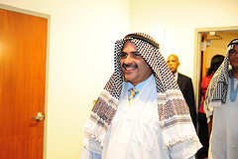

Slide 17
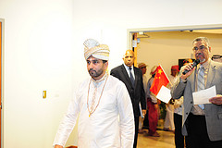

Slide 18
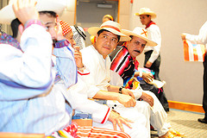

Slide 19
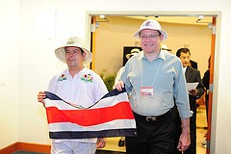


Slide 20
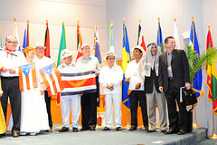

Slide 21


Slide 22
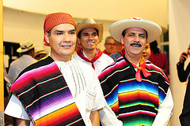

Slide 23
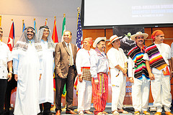

Slide 24
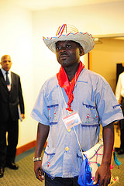

Slide 25
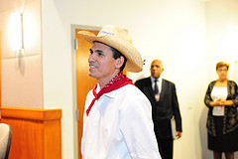

Slide 26


